Slide 1
BUS TICKETING KICK-OFF
March 2025

Slide 2
AGENDA
OVERVIEW
COMMUNICATION WORKFLOW
TEAM STRUCTURE
HIGH LEVEL SCHEDULE
HUMAN RESOURCE
HIGH LEVEL REQUIREMENT
ROLES & RESPONSIBILITIES
RISKS & MITIGATION
‹#›
‹#›￼

Slide 3
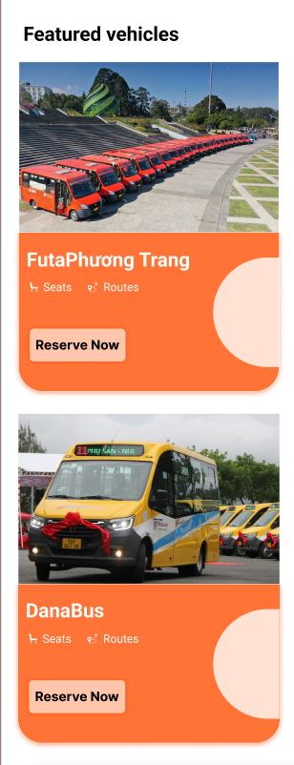
OVERVIEW
PROJECT NAME / CODE
CLIENT NAME
BUS TICKETING/ BTM-0625
TRAN XUAN VU
PROJECT TYPE
PROJECT MANAGER
SOFTWARE PROJECT
NGUYEN NHUAN TIEN
PROJECT DESCRIPTION
THIS PROJECT INVOLVES BUILDING AN ONLINE BUS TICKET BOOKING SYSTEM WHERE USERS CAN SEARCH AND BOOK SEATS FOR THEIR TRIPS.
‹#›

Slide 4
OVERVIEW
DURATION
ESTIMATION
February 1, 2025 to July 31, 2025
<60 Man Months>
PLATFORMS/TECHNOLOGIES
PROJECT OUTPUT
Mobile
iOS application
Android application
GOALS / OBJECTIVES
Phase 1 Build interfaces for mobile applications (Android, iOS).
Phase 2 Allows users to search for bus routes, choose seats, book tickets, and pay online.
Phase 3 Improved user experience (UX/UI) for faster ticket booking.
‹#›

Slide 5
TEAM STRUCTURE
DM
Vu Tran
QA
PM
Architect
Ngoc
Vi
Tien
BA
Nhung
iOS Lead
Android Lead
FE Lead
QC Lead
Van
Tri
Hung
Nghia
Su
Kiet
Dong
Quynh
Hoa
Tuan
Duong
Vinh
Diep
‹#›

Slide 6


HUMAN RESOURCE
1
0.5
3.5
3
3.75
2.5
3.5
PM
BA
FE
iOS
Android
QC
Comtor
2023
‹#›

Slide 7
ROLES & RESPONSIBILITIES
Role | Responsibilities
PM | Manage the overall project, create plans, assign tasks, monitor progress, resolve issues, and ensure the project is completed on time and within budget.
Architect | Design the system architecture, ensure performance, security, and scalability, and provide technical guidance to the development team.
BA | Gather, analyze, and define business requirements from clients. Convert requirements into specification documents for the development team.
DEV | Develop and implement the software, including front-end (FE) and back-end (BE) logic. Collaborate with BA and QC to meet project requirements.
QC | Test the software, identify bugs, verify correctness, and ensure the system is stable before deployment.
Comtor (Communicator - Interpreter) | Assist in translation and communication between clients and the development team (if the project involves multiple languages).

Slide 8
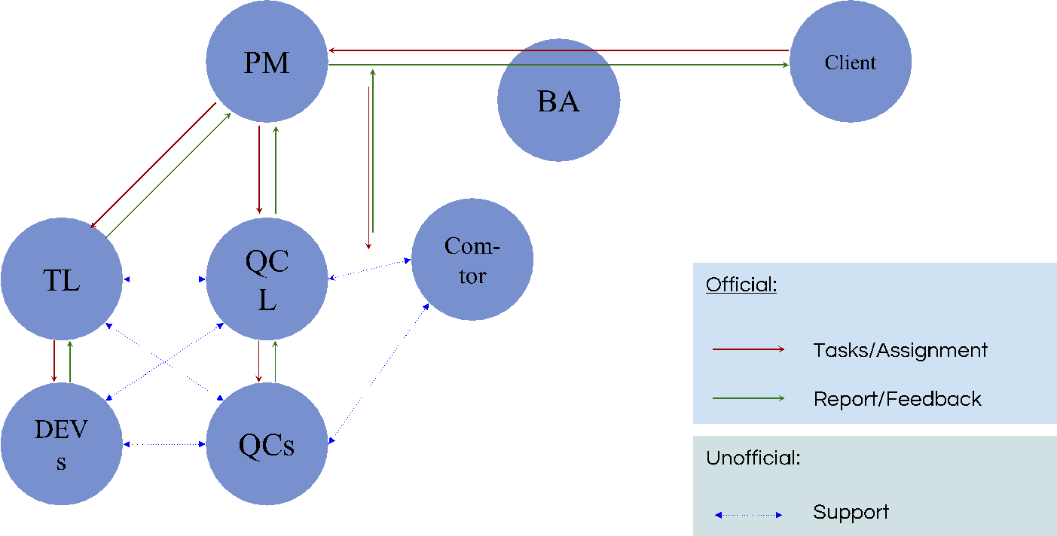
COMMUNICATION WORKFLOW

Slide 9
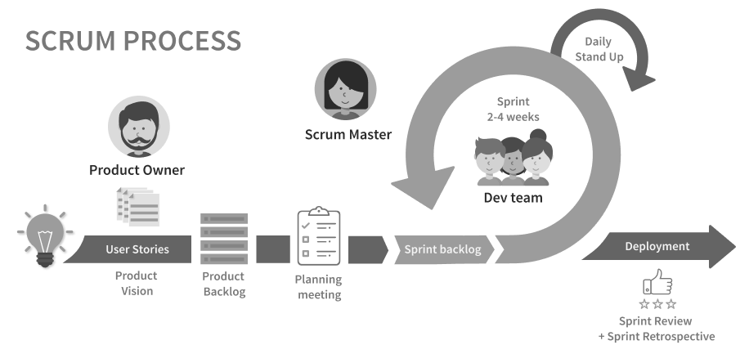
Development Process
Planning meeting
8:30am VN Time, held every 2 weeks on Monday’s Daily meeting
8:30am VN Time, held daily
Demo meeting (Whole team)
2pm VN Time, held every 2 weeks on Friday’s
Retrospective
2pm VN Time, held every 2 weeks on Monday’s
Sprint duration
Held every 2 weeks

Slide 10
HIGH LEVEL SCHEDULE
Project Start Date
…
01/03
01/02
Requirement & Design Completion
…
2025

Slide 11
HIGH LEVEL SCHEDULE
Beta Version Release
Project End
…
01/06
…
31/07
2025

Slide 12
Timeline
February 1 → February 7 Sprint 0 - Warm up
Gather customer requirements
Define project scope and goals
Set up development environment
February 15 → March 15 Sprint 1
Develop user registration & authentication
Implement bus route search and scheduling
Build initial database and backend APIs
March 20 → April 15 Sprint 2
Develop ticket booking and seat selection
Integrate online payment system
Implement booking history and cancellation policies
April 20 → May 15 Sprint 3
Improve UI/UX based on feedback
Add notification system for bus arrival times
Optimize system performance and security
May 20 → June 30 Sprint 4
Conduct system testing (QA & UAT)
Fix critical bugs and optimize performance
Prepare deployment documentation
July 1 → July 31 Final Sprint
Deploy the system for public use
Provide training and support
Conduct project review and closure

Slide 13





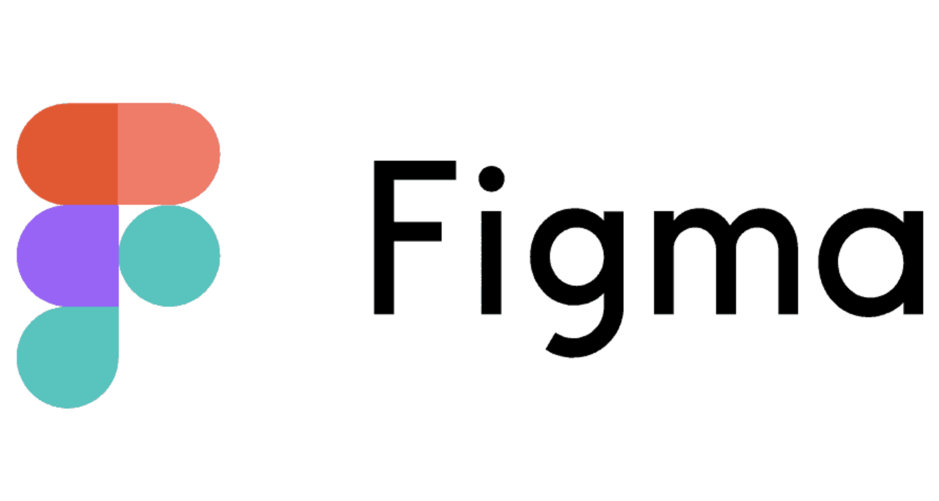
Software Tools
Tasks/Defects Management
Communication
Documentation
Source code
Design

Slide 14
HIGH LEVEL REQUIREMENTS
No. | Requirement Description
1 | The service will be alive with 10000 requests at the same time.
2 | The system must support real-time bus tracking and estimated arrival times.
3 | Users should be able to book, cancel, and modify tickets within the app.
4 | The platform must integrate secure online payment methods (credit card, e-wallets, etc.).
5 | The application should provide multilingual support, including Vietnamese and English.
6 | The system must send notifications for ticket confirmation, reminders, and updates.

Slide 15
RISKS & MITIGATION
Risk | Mitigation
Server down | Backup configuration of routers
Traffic overload | Implement load balancing and scale up as needed
Payment system failure | Set up backup payment methods and monitor transactions
User data leakage | Encrypt data and enhance system security
Users encountering booking errors | Establish 24/7 customer support and conduct thorough testing before deployment
Bus delays or schedule changes | Integrate real-time notification system for passengers

Slide 16
Thank you!

